Slide 1
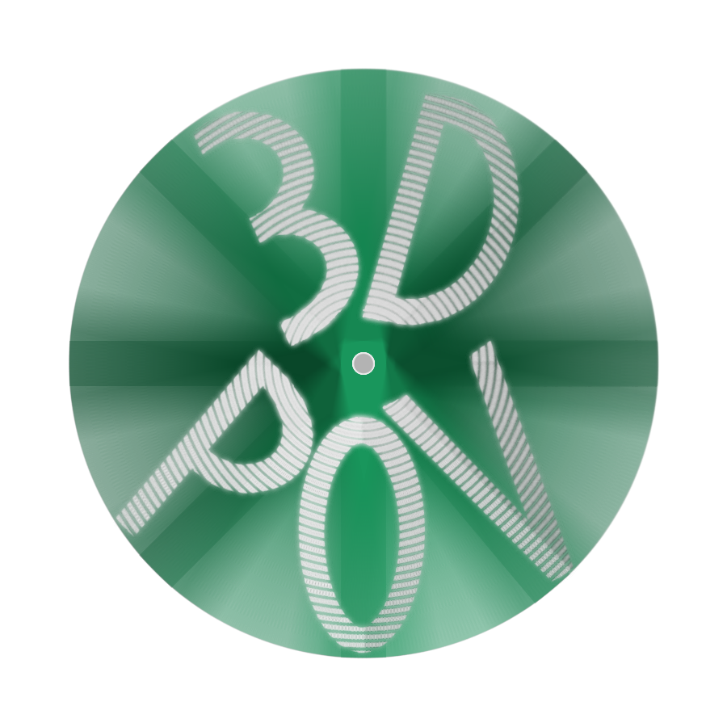
3DPOV Display
Philip D. Geramian, Alex Julian, Lyle Moffitt, Roman Olesh
Syracuse University College of Engineering and Computer Science
April 18, 2015

Slide 2
Team Members
Philip D. Geramian
Major: Computer Engineering
Alex Julian
Major: Electrical Engineering
Minor: Mathematics
Roman Olesh
Major: Electrical Engineering
Lyle Moffitt
Major: Computer Engineering

Slide 3
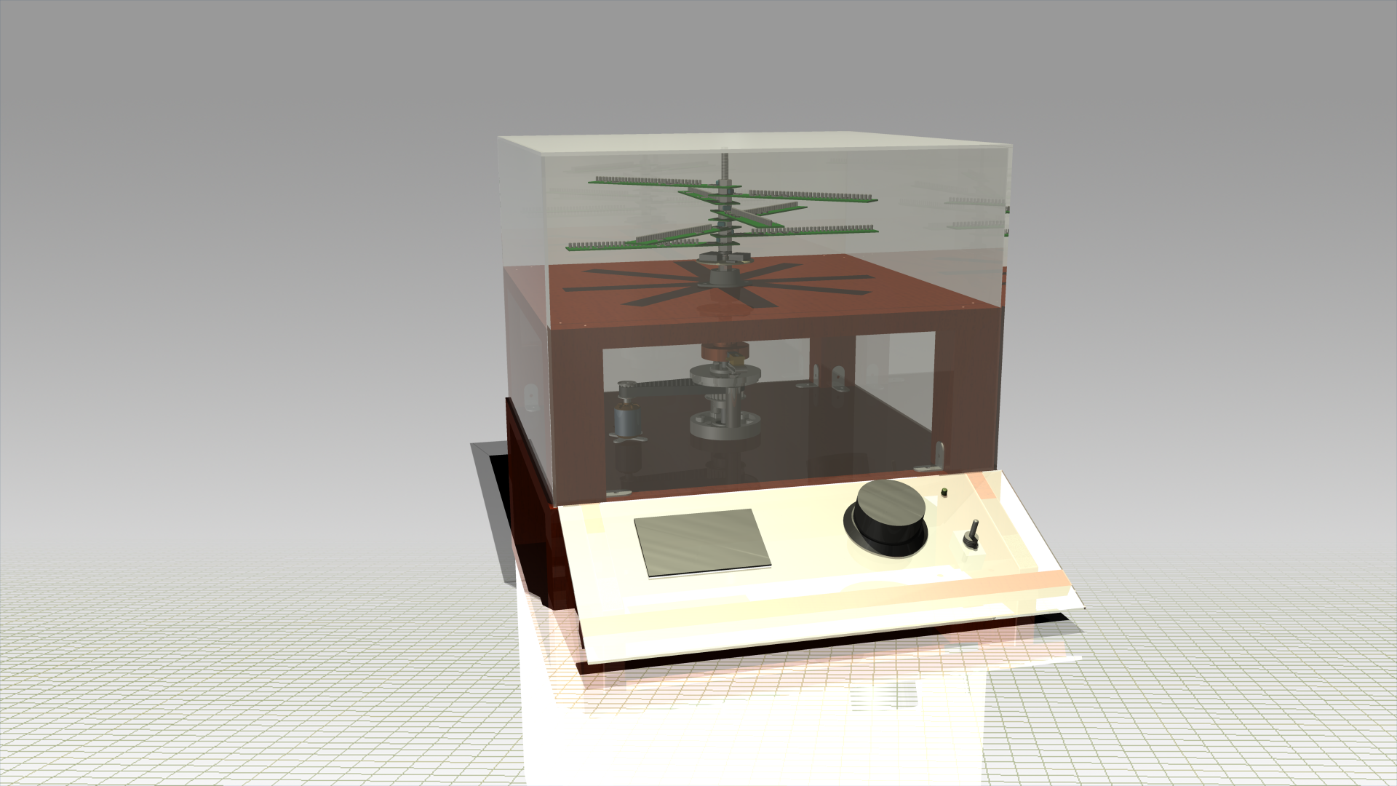
Project Description

Slide 4
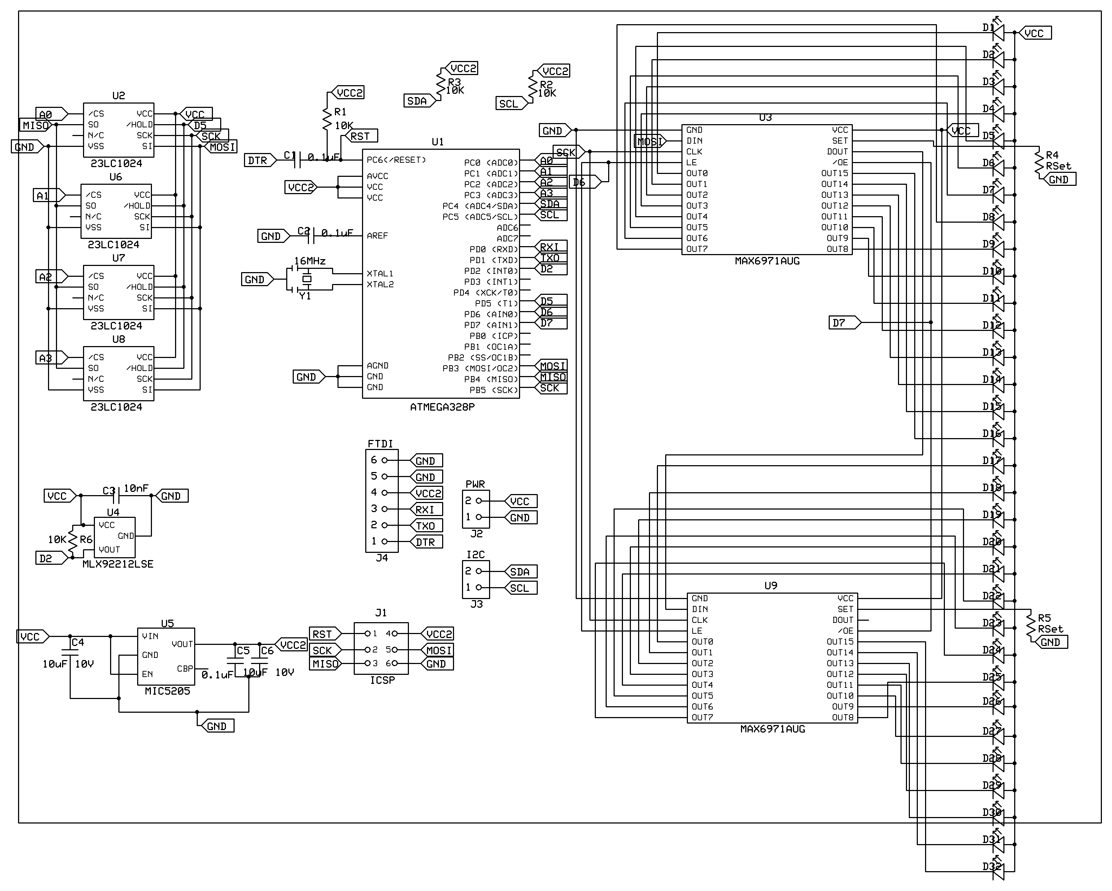
Hardware Description
3mm White LEDs
SRAM
µCU
LED Drivers
Hall Effect Sensor
FTDI, ICSP, Power, and I2C Headers
LDO Voltage Regulator

Slide 5
Software Description
Beagle Bone (Frontend)
Arduino (Backend)
Import Source
Slice
Tool: Slic3r
Rasterize
Tool: Ghostscript
Source: Online
Type: application/vnd.ms-pki.stl
Type: image/svg+xml
Type: application/vnd.cups-raster
Transform
Cartesian to Polar
Scale resolution
Type: application/octet-stream
Transfer
SPI over RF
I2C to blades
Interrupt Source
Hardware Timer
Hall-Effect
I2C Tx/Rx
Reset Timer
Load Buffer From SRAM
Print LEDs From Buffer
Change SRAM Source
Load To SRAM
SPI Tx/Rx
Load SRAM
I2C Transfer

Slide 6
Engineering Challenges
Data flow
Supplying Power
Mechanical Balancing
ExpressPCB

